Slide 1
“Nudging” Entrepreneurship
Prof. Barton Hamilton
Robert Brookings Smith Distinguished Professor of Entrepreneurship
Olin Business School

Slide 2
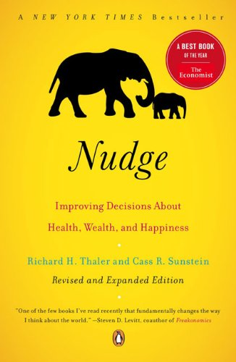
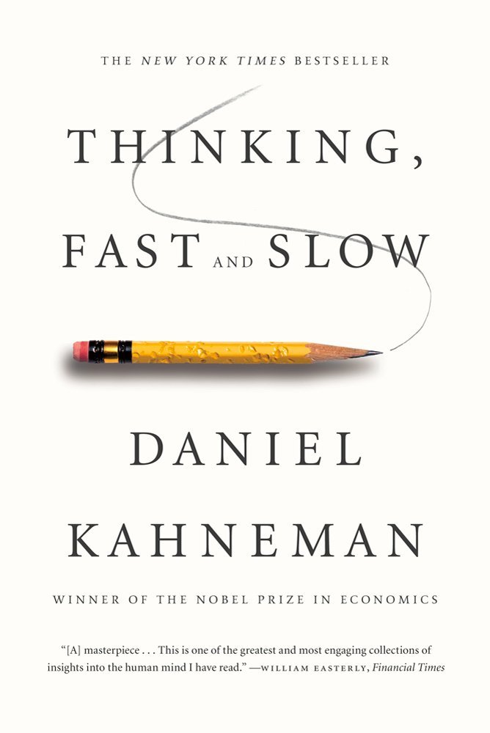
Recent Bestselling Business Books

Slide 3
Outline for Today
How can a startup improve the odds of success?
What insights can we gain from behavioral economics?
Implications of behavioral economics for decision-making.
Applying these insights to entrepreneurship: The Power of Pain
Using PoP to generate ideas
Using PoP to evaluate ideas
Using PoP to communicate ideas

Slide 4
What determines whether a new product/start-up will be successful?

Slide 5
Factors Affecting Entrepreneurial Success
The Entrepreneur
The “Small Firm Effect” (Elfenbein, Hamilton, Zenger 2010)
Personality (Hamilton & Papageorge 2013)
Genetics
“Mistakes” (Heger and Papageorge 2013)
Financing
Liquidity Constraints and Angel/VC
Intellectual Property
R&D (Hamilton & Janpen 2013)

Slide 6
What Really Matters?

Slide 7
What Really Matters?
Will a customer buy the product?
Will a customer change their behavior and try something new?!

Slide 8
Why is Change So Hard?

Slide 9
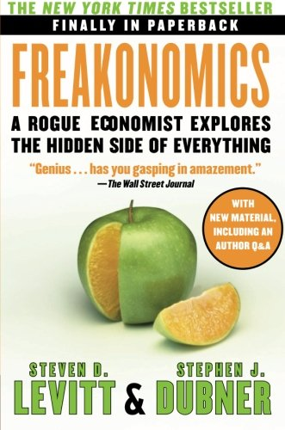
Neoclassical Economics
Individuals make rational choices
Respond to incentives
Compare discounted flows of returns from alternative activities
Choose option that maximizes utility

Slide 10
Elements of Rational Decision Making
Individuals make choices to maximize some objective function (usually utility function) under the constraints that they face
Utility function is stable
If there is uncertainty, individuals maximize expected utility by assigning probabilities to different states of the world
Implications:
Compare opportunity cost of various decisions
Pursue an activity until marginal benefit equals marginal cost
Sunk costs are sunk
Consistent behavior
More choice is better
→ Great strength is that we can rely on choices to infer preferences – idea of revealed preference.

Slide 11
Behavioral Economics
Fastest growing field in economics
Behavioral economics is concerned with the ways in which the actual decision-making process influences the decisions that are made in practice; combines psychology and economics
Assumes bounded rationality – meaning that people have limited time and capacity to weigh all the relevant benefits and costs of a decision.
Decision making is less than fully rational. People are prone to make predictable and avoidable mistakes.
At the same time, decision making is systematic and amenable to scientific study.

Slide 12
Six Key Ideas from Behavioral Economics
1. Framing. Allowing the way a decision is presented to affect the choice that is selected even though the marginal benefit and marginal cost are unaffected.
2. Letting Sunk Costs Matter. Allowing sunk costs, which have already been paid and do not affect marginal costs regardless of which option is chosen, to affect a decision.
3. Faulty discounting. Being too impatient when it comes to decisions that involve benefits that are received in the future or discounting future benefits inconsistently depending on when the delay in receipt of benefits occurs.
4. Overconfidence. Believing you will know what will happen in the future to a greater extent than is justified by available information.
5. Status Quo Bias. A tendency to make decisions by accepting the default option instead of comparing the marginal benefit to the marginal cost.
6. Desire for Fairness and Reciprocity. A tendency to punish people who treat you unfairly and to reward those who treat you fairly, even if you do not directly benefit from those punishments and rewards.
NB: Behavioral Economics recognizes that people respond to incentives, but their response is not always a rational one.

Slide 13
Overconfidence
In US firms with employer stock as a 401(k) option, around 40% of retirement savings is invested in employer stock.
This choice reveals many things, among them, confusion about the risk characteristics of employer stock and overconfidence.
On average, US workers report that their own employer’s stock is less risky than a diversified mutual fund.
The lessons of Enron, Worldcom, and Global Crossing were not heeded by workers outside of those firms (Choi, Laibson and Madrian 2005).
New workers at other firms failed to avoid employer stock.
Even new workers at other Houston firms failed to avoid employer stock after Enron collapsed.
Still, direct personal experience helps with learning

Slide 14
Example: Overconfidence and Worker Retention
In a recent paper, “Training Contracts, Worker Over-Confidence, and the Provision of Firm-Sponsored Training,” Hoffman examines the relationship between overconfidence and worker retention at a large trucking firm.
Workers undergo driver training, paid for by the firm.
Trainees must pay $3500 if they leave the firm in the next year.
Drivers then paid by the mile
Potential workers will accept this contract if they think they will like being a truck driver, and will be good at it.
If you are over-confident about your ability, more likely to accept the contract!

Slide 15
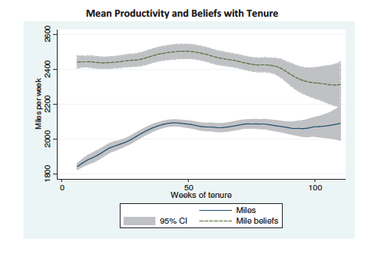
Are Trainees Over-Confident?

Slide 16
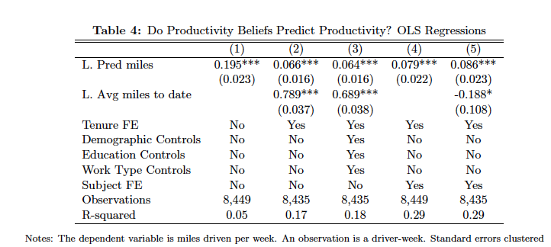
Does Over-Confidence Affect Productivity?

Slide 17
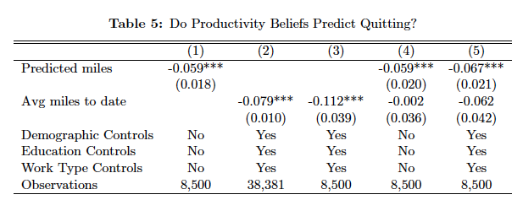
Does Over-Confidence Affect Retention?

Slide 18
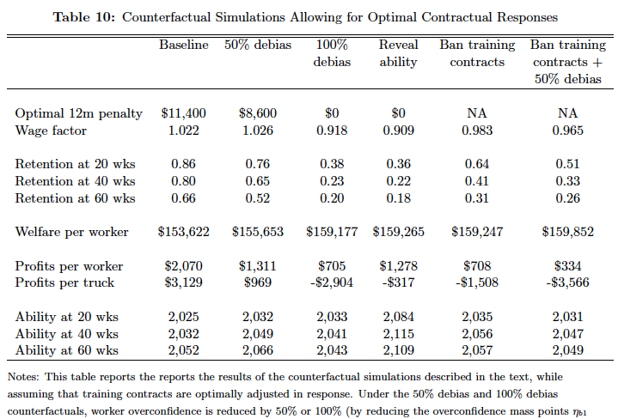
Does Worker Over-Confidence Increase Firm Profits?

Slide 19
Over-Confidence and Entrepreneurship (Heger & Papageorge 2013)
Attempt to simulate a startup environment in the lab.
Participants asked to assess the likelihood that their “business” will be successful
Think of the business as opening a restaurant.
Participants tended to substantially overstate the likelihood that the “restaurant” will be successful
Men: Over-confident about their ability as a “chef/entrepreneur”
Women: Overly optimistic about how much customers like “Thai” food. Not over-confident about their ability as “chef/entrepreneur”.
Similar findings in other lab contexts:
Men over-confident about their abilities
New result:
Women more likely to be overly optimistic.

Slide 20
Status Quo Bias
Decision-makers have an overwhelming tendency to adopt defaults, to stick with the status quo
Even when the decision is important and the stakes are large
Even when the decision-maker is told that the default is suboptimal
Examples from 401(k) plans: participation, savings rate, asset allocation (company stock).
Other examples: insurance deductibles, organ donation

Slide 21
Example: Brigitte Madrian and Dennis Shea (2001) • Design: A Fortune 500 Company Switched 401(k) default on April 1, 1998. Madrian and Shea examine behavior of new hires.
OLD
Default Contribution: Must actively sign up
Default Allocation: None
NEW
Default Contribution: 3 percent of compensation deducted for plan
Default Allocation: Money Market Fund

Slide 22
401(k) Participation Increases Percent at Specified Contribution Rate
Contribution Rate
Source: Madrian and Shea (2001).

Slide 23
401(k) Asset Allocation Also Changed
Percent of Assets
Source: Madrian and Shea (2001).

Slide 24
Impact of Automatic Enrollment in 401(k) Before, During and After
Source: Choi, Laibson,
Madrian, Metrick (2004)

Slide 25
Is More Choice Always Better?
Adding more complex options:
Complexity delays choice, increasing the fraction of consumers who adopt default options (O’Donoghue and Rabin, 2004).
Complexity biases choice, since people tend to avoid complex options (Shafir and Tversky, 1994; Iyengar and Kamenica, 2006).
1/N rule – Add a second fund and many investors divide portfolio 50-50; add a third fund and 1/3 placed in each.

Slide 26
Faulty Discounting
People display inconsistent behavior when choosing for today or for tomorrow
Many choices involve benefits and costs that are received at different times
People tend to be impatient in the short-run. Causes irrational (inconsistent) choices.
Example: Would you rather receive $100 right now or $101 in a week? Most people choose $100 right now. But when the choice is between $100 a year from now and $101 in a year and a week from now, most people choose $101 in a year and a week. → More impatient for decisions involving this week than next year. This is inconsistent, as both choices involve delaying the receipt of $1 by a week.
Technical term is “hyperbolic discounting”.

Slide 27
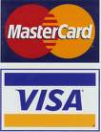
Real Consequence of Faulty Discounting
The average adult has $6,000 of outstanding credit card debt. Few people can afford to pay off $6,000 in full, so many make only the minimum payment each month and pay interest at very high rates on the balance. Why? The attraction of immediate consumption is hard to resist. (Status quo bias prevents many people from taking a bank loan at lower interest to pay off credit card debt.)

Slide 28
Inconsistent Choices Due to Impatience
Eat chocolate today with delayed health consequences but immediate gratification, or eat fruit today with less gratification but better long-term health consequences.
What do you choose today for you to eat next week? What do you choose today to eat today?
Research by Daniel Read and Barbara van Leeuwen (1998)

Slide 29
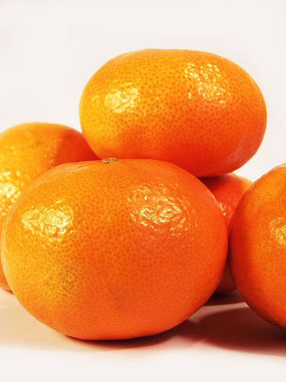
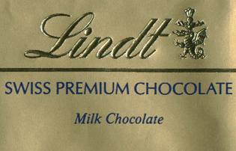
Choosing fruit vs. chocolate
Choosing Today
Eating Next Week
Time
If you were
deciding today,
would you choose
fruit or chocolate
for next week?

Slide 30
Patient choices for the future:
Choosing Today
Eating Next Week
Time
Today, subjects
typically choose
fruit for next week.
74%
choose
fruit

Slide 31
Impatient choices for today:
Choosing and Eating
Simultaneously
Time
If you were
deciding today,
would you choose
fruit or chocolate
for today?

Slide 32
Time Inconsistent Preferences:
Choosing and Eating
Simultaneously
Time
70%
choose
chocolate

Slide 33


Impatience: the desire for instant gratification Read, Loewenstein & Kalyanaraman (1999)
Choose among 24 movie videos
Some are “low brow”: My Cousin Vinny
Some are “high brow”: Schindler’s List
Picking for tonight: 56% of subjects choose low brow.
Picking for next Thursday: 37% choose low brow.
Picking for second Thursday: 29% choose low brow.
Tonight I want sugar-coated entertainment… next week I want things that are good for me.

Slide 34
How Important are Immediate Rewards?

Slide 35
“Learning and the Inefficient Exit of Entrepreneurs”
Have 2 startups, A and B
Consider the profits earned over 2 periods:
Entrepreneur A: earns $100 in year 1; $100 in year 2
Entrepreneur B: earns $50 in year 1; $150 in year 2
Is B more likely to exit than A?
Standard story: No
Behavioral Economics: Yes, due to impatience

Slide 36
“Learning and the Inefficient Exit of Entrepreneurs”
We examine whether impatience leads entrepreneurs to exit their businesses “too early”
Occurs if they earn low initial profits, but “business fundamentals” look good.
Data from 5000 startups founded in 2004:
About 50% failed by 2010
About 20% of the failures exited “too early”
Impatience implies that these individuals who “failed” could have succeeded if they were not so myopic!

Slide 37
Loss Aversion
Losses loom larger than equivalent gains
Kahneman, Knetsch and Thaler (1990) found that randomly assigned owners of a mug required significantly more money to part with their possession (around $7) than randomly assigned buyers were willing to pay to acquire it (around $3).
This can be attributed to loss aversion: owners’ loss of the mug loomed larger than buyers’ gain of the mug. Usually 2:1 ratio.
Causes a divergence between willingness to buy and willingness to sell. Sometimes called “the endowment effect”

Slide 38
Bounded Rationality: Thinking Is Costly
A baseball and bat together cost $11. The bat costs $10 more than the ball. How much does the ball cost?
Write down your answer.

Slide 39
Bounded Rationality: Thinking Is Costly
Half of Harvard students said $1, which is the intuitive answer but wrong!
Correct answer is 50 cents: $10.50-$.50 = $10.00
People tend to use “intuitive thinking” or rules of thumb
A baseball and bat together cost $11. The bat costs $10 more than the ball. How much does the ball cost?
Write down your answer.

Slide 40
Implications of Behavioral Economics for the Entrepreneur
Getting someone to try your product is much more difficult than you think (status quo bias)
“If only 1% of Chinese households try our product our revenues will be…”
Another choice for consumers does not always add value.
Payoff needs to be immediate
“Over 3 years our product will save consumers $$...”
Benefits have to be obvious

Slide 41
What determines whether a new product/start-up will be successful?

Slide 42
The Power of Pain
Why the brightest innovations grow out of the darkest emotions!
This portion of the talk drawn from lectures by Chris O’Leary (www.chrisoleary.com)

Slide 43
What’s the Difference?
Necessary (but not sufficient) characteristics of successful innovators:
Creative
Risk-takers
Problem-solvers
Distinguishing characteristics of successful (vs. unsuccessful) innovators:
Significant personal familiarity with both the problem and the stare of the art.
Solved a problem that was causing large numbers of people significant amounts of pain.

Slide 44
The Power of Pain
If you want to improve your ability to generate, evaluate, and communicate ideas for innovations you must put pain at the center of your efforts!

Slide 45
Why Pain?
Change makes or breaks innovations.
If people change and adopt your innovation, then you will be successful. If they don’t, you won’t.
Most people hate to change, and will not change without a good reason
Only the existence of significant amounts of physical or psychic pain will consistently drive people to change.

Slide 46
“All experience hath shown, that mankind are more disposed to suffer, while evils are sufferable, than to right themselves by abolishing the forms to which they are accustomed.” The Declaration of Independence

Slide 47
The Limits of Pleasing People
Less pain = less reason to change
Pain = Must-have
Pleasure = Nice-to-have
Pain = High priority
Pleasure = Low priority

Slide 48
The Problem with Being Pleasure-Driven
Risky
No good reason for the customer to prefer your product/service over another one.
Success = Luck
Lower margins and profits
Lower odds of being successful

Slide 49
The Benefits of Being Pain-Driven
Harder for the customer to walk away from the sale.
Shorter sales cycle
Greater word of mouth
Lower levels of sales and marketing expenses
Higher margins!
Larger profits!
Improved odds of succeeding

Slide 50
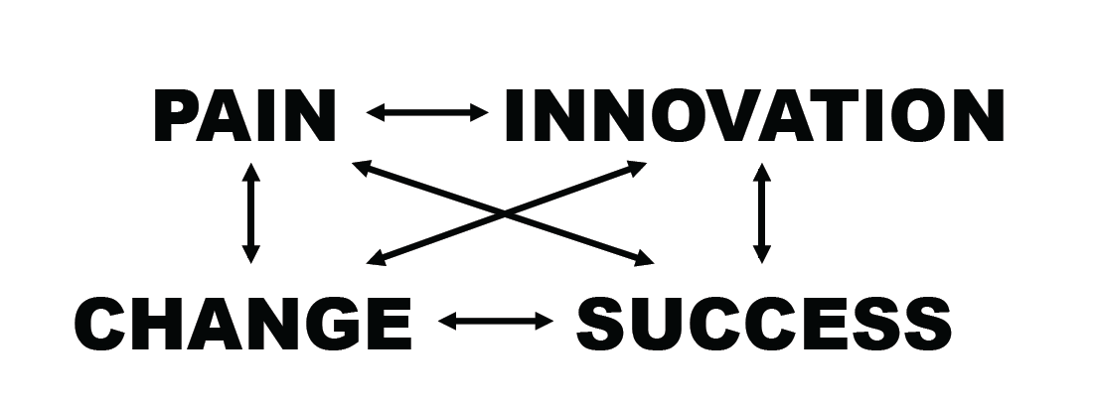
What is the Right Path?

Slide 51
Case Study
The Story of Howard Head

Slide 52
Takeaways for Entrepreneurs

Slide 53
The Purpose of Pain is to Drive Change
Pain is a blessing, not a curse

Slide 54
Don’t Take Customer Change for Granted
Change is hard
Difficulty of organizational change
Personal change!
Status Quo bias

Slide 55
Satisficing vs. Optimizing
What is the best?
What is “good enough”?
How important are switching costs?

Slide 56
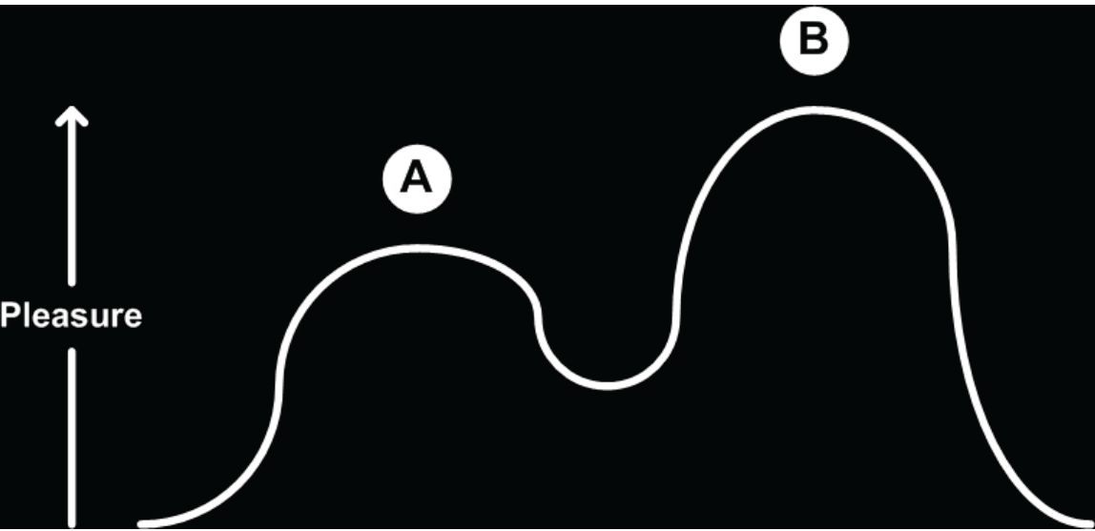
Transitional Pain

Slide 57
Prospect Theory
Kahneman and Tversky
Consider 2 payment schemes:
Pay you $90 plus a 50% chance of winning $20
Pay you $110 plus a 50% chance of losing $20
Which option would you choose?

Slide 58
Losses Loom Larger Than Gains
People are risk seeking in the domain of losses
People are risk averse in the domain of gains
Relative changes often matter more than absolute values
Negativity effect
Assign more weight to negative information
If you do not like someone, attribute negative behaviors to the individual, positive behavior to the environment

Slide 59
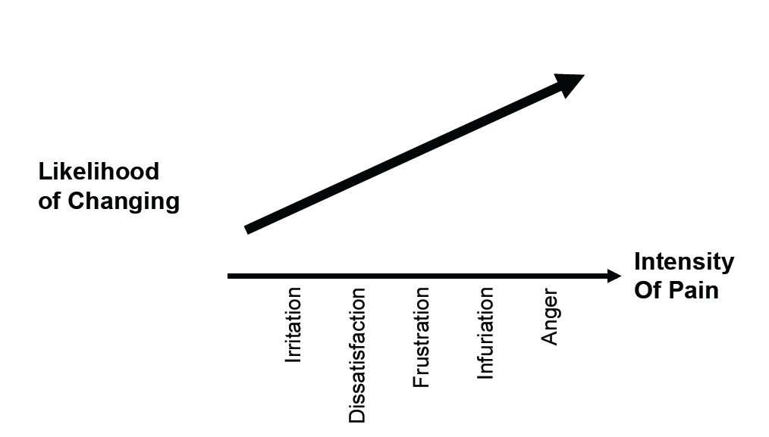
Solving a Problem is Not Enough: How I Thought Change Worked

Slide 60
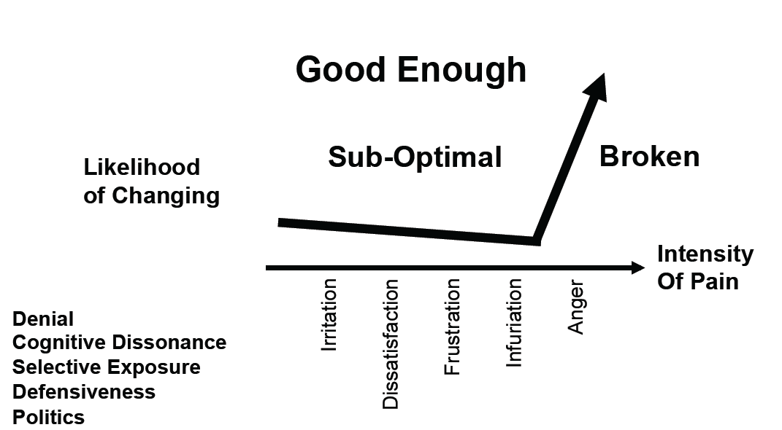
Solving a Problem is Not Enough: How Change Actually Works

Slide 61
Why Isn’t Solving a Problem Good Enough
Denial
Cognitive Dissonance:
People have a bias to seek consonance between their expectations and reality
Selective Exposure
Only choose information that is consistent with your choices
Defensiveness
Politics

Slide 62
There’s More to Innovation than Creativity
Creativity is important, but it is not enough
Not every problem is a good problem.
Strategy vs. tactics
Why vs. what &how
Innovation = Find the problem
Creativity = Solve the problem

Slide 63
Get the Sequence Right
SISOAP:
The Solution ➔ The Problem (the Pain)
Confirmation bias
“Engineer-entrepreneurs”
Build It ➔ Sell It
If the existence of a painful problem is so important, put pain first, not last.
Pain-driven:
The Pain ➔ The Problem ➔ The Solution
Sell It ➔ Build It

Slide 64
Why it is Important that Pain Focuses You on “Pull” Not “Push”
Overconfidence
Tend to believe that I can make people want my product.
Illusion of control
Tendency for people to over-estimate their ability to control events
The third person effect
Wait for someone else to do something (e.g., adopt a new product)

Slide 65
How Can I Use the Power of Pain to Generate Ideas?

Slide 66
How Can You Use the Power of Pain to Generate Ideas?
Cultivate Indignation!
What-a-Pita model of entrepreneurship!
Cues
Watchwords
Pluralistic Ignorance
Majority of group members privately reject a norm, but incorrectly assume that others accept it.

Slide 67

Simon Hall Doors!

Slide 68

Simon Hall Doors!

Slide 69
How Can I Use the Power of Pain to Evaluate Ideas?

Slide 70
Ask The Three Questions
What problem does it solve?
What pain does it alleviate?
Who cares?

Slide 71
Case Study
Yla Eason

Slide 72
Every Problem is Not a Good Problem
“Bad” problems:
Metric system
The Concorde
Pocket Protectors
Easy Spirit shoes

Slide 73
Is It a Good Problem?
Do you understand the customer?
Do you understand the problem?
Real problems, not hypothetical problems!
Drycleaners.com
Pets.com
Focus on problems you understand
Eat your own dog food!

Slide 74
Beware the Curse of Incrementalism
Too many innovations are just an “11”
The problem with expertise
The Innovators Dilemma, by Clay Christensen
Firms “listen to their customer” and focus on incremental innovation
Miss the disruptive innovation that is valuable to the broader market.

Slide 75
Using Pain to Communicate Your Idea

Slide 76
Pain is the Fifth “P”
Place
Product
Price
Promotion
Pain!
Communicates the value of your idea.

Slide 77
Answer the Three Questions
What problem does this solve?
What pain does it alleviate?
Who cares?

Slide 78
Lead with Pain
The “Vision Thing”
The Declaration of Independence
Don’t get lost in the HOW
Declaration of Independence vs. the Constitution
Remember the sequence:
Problem ➔ Pain ➔ Solution Structure

Slide 79
My Philosophy
You can’t change people
Pull not push
The customer not the solution
Valuable, not new and different
PR and WOM, not advertising
Realistic, not idealistic
Listening, not talking
Tangible, not hypothetical

